Slide 1

Concurrent Programming: Process and threads
MTS 2
Object Oriented Programming

Slide 2
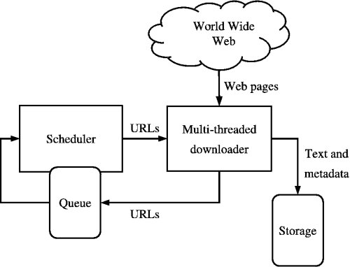

Slide 3
What is a thread?
First we need to know a little about concurrency.

Slide 4
Multi-tasking
We frequently take for granted that our computers can do more than one thing at a time.
http://java.sun.com/docs/books/tutorial/essential/concurrency/index.html

Slide 5
Single Applications
Even a single application is often expected to do more than one thing at a time.
Example: Streaming video application must simultaneously:
Read the digital audio off the network
Decompress it
Manage playback

Slide 6
Another example
Even Word should always be ready to:
Respond to keyboard events
Handle mouse events
No matter how busy it is:
Reformatting text
Updating the display

Slide 7
Concurrency
Software that can do such things is known as concurrent software.

Slide 8
Java and concurrency
Java was designed from the beginning to support development of concurrent applications

Slide 9
Concurrent programming
In concurrent programming, there are two basic units of execution: processes and threads.
What do I mean by unit of execution?
In Java, concurrent programming is mostly concerned with threads.
However, processes are also important.

Slide 10
What is a program?
How do you conceive of a program running on your machine?
What are its properties?

Slide 11
Program
A program is one process or two or more cooperating processes

Slide 12
What is a process?
A self-contained execution environment
Code
Data (variables, etc.)
Available unallocated memory
Program counter

Slide 13
Time slicing
A computer system normally has many active processes and threads.
A single core can have only one thread actually executing at any given moment.
Access to the processor is shared among processes and threads
Accomplished through an OS feature called time slicing
Small fractions of a second for each turn

Slide 14
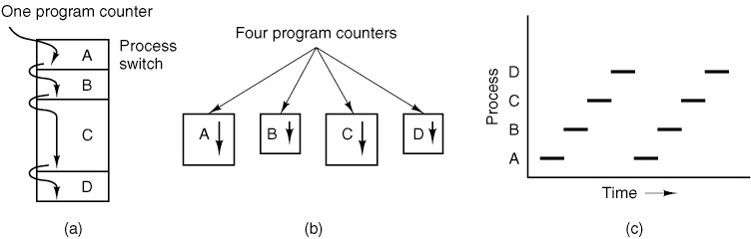
Time slicing visually

Slide 15
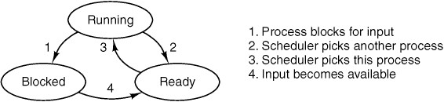
Process states

Slide 16
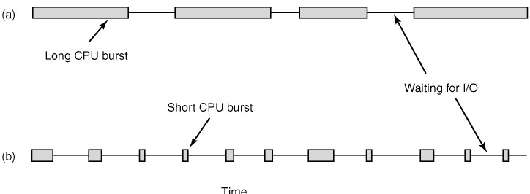
Crawler threads are I/O bound

Slide 17
Multi-core machines
Even machines with multiple execution cores use time slicing on the individual processors
Each processor serves as the execution hub for many processes

Slide 18
Inter process communication
Most OSs support Inter Process Communication (IPC) resources
Pipes
Sockets
IPC also identifies communication between processes on different systems.

Slide 19
JVM – Single process
Most implementations of the Java virtual machine run as a single process
Java programs are frequently a single process with many threads

Slide 20
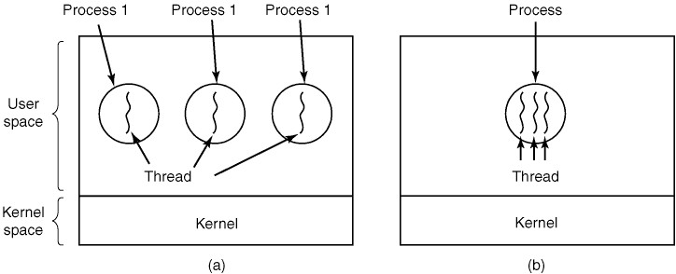
Cooperating processes
Three processes each with one thread.

Slide 21
One process - cooperating threads
One process with three threads.

Slide 22
Shared execution environment
Shared
Code
Some data (variables, etc.)
Unique
Program counter
Some data

Slide 23
Thread Objects
Each thread is associated with an instance of the class Thread.
To directly control thread creation and management, simply instantiate Thread each time the application needs to initiate an asynchronous task.

Slide 24
Defining and starting a thread
An application that creates an instance of Thread must provide the code that will run in that thread.
Class should implement Runnable interface
Method run() meant to contain the code executed in the thread.
The Runnable object is passed to the Thread constructor, as in the HelloRunnable example.
Note the use of Thread.start to start the new thread.

Slide 25
Pausing execution with sleep
Thread.sleep() causes the current thread to suspend execution for a specified period.
Efficient means of making processor available to the other threads
Pacing
Waiting for another thread to perform some task.
Specify sleep in milliseconds
Sleeping threads can be woken up by an interrupt.
The SleepMessages example uses sleep to print messages at four-second intervals

Slide 26
Sleep Messages example
Notice that main() declares that it throws InterruptedException.
Thread.sleep() throws this when another thread interrupts it.
This application has not defined another thread to cause the interrupt.
So we do not bother to catch the exception

Slide 27
Interrupts
An interrupt signals a thread to stop what it is doing and do something else.
The programmer decides exactly how a thread responds to an interrupt.
Very common for the thread to terminate
A thread sends an interrupt by invoking interrupt on the Thread object to be interrupted.
The interrupted thread must support its own interruption.

Slide 28
Supporting interruption
How does a thread support its own interruption?
Typically, this is done by simply catching InterruptedException and responding appropriately.
Can also use:
Thread.interrupted()
Thread.isInterrupted()

Slide 29
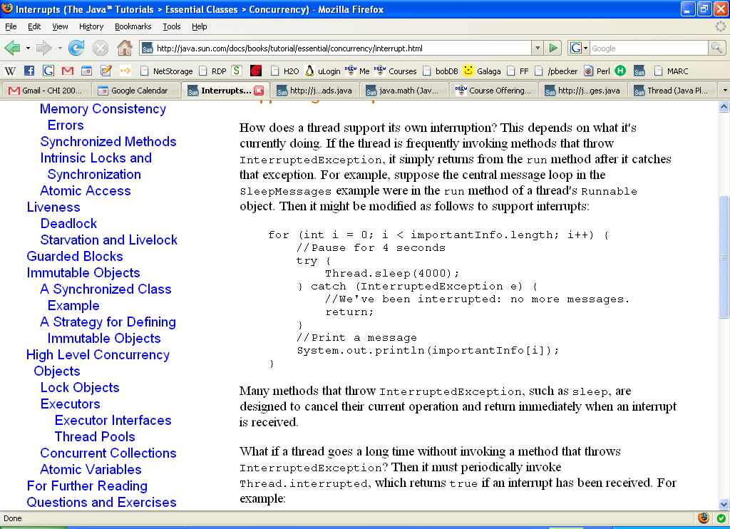
Catching InterruptedException

Slide 30
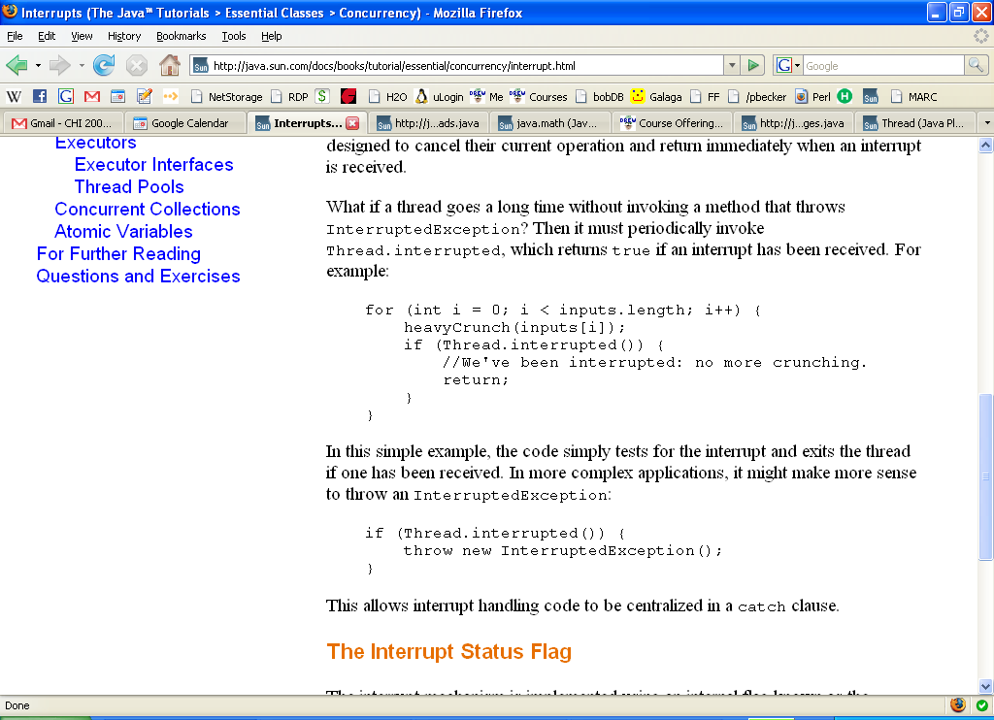
Using Thread.interrupted()

Slide 31
The interrupt status flag
The interrupt mechanism is implemented using an internal flag known as the interrupt status.
Invoking Thread.interrupt sets this flag.
Thread.interrupted checks, then clears this flag. (static method)
Thread.isInterrupted just checks the interrupt status. (instance method)
A method that exits by throwing an InterruptedException clears interrupt status.

Slide 32
Joins
The join method allows one thread to wait for the completion of another.
If t is a Thread object whose thread is currently executing, t.join(); causes the current thread to pause until t exits.
Overloads of join allow the programmer to specify a waiting period.

Slide 33
Simple Threads example
SimpleThreads consists of two threads.
The first is the main thread that every Java application has.
The main thread creates a new thread from the Runnable object, MessageLoop, and waits for it to finish.
If the MessageLoop thread takes too long to finish, the main thread interrupts it.
The MessageLoop thread prints out a series of messages.
If interrupted before it has printed all its messages, the MessageLoop thread prints a message and exits.

Slide 34
The End

